Slide 1
Fuzzy Logic & Markov Systems Session 09
Course : COMP6228 – Artificial Intelligence
Effective Period : February 2018

Slide 2
Learning Objective
After completing this session, students are expected to be able to:
LO 2 : Explain concepts of AI Techniques in Games

Slide 3
Content
Fuzzy Logic Decision Making
Fuzzy State Machines
Markov Processes
Markov State Machine

Slide 4
Fuzzy Logic Decision Making
There are several things we can do with fuzzy logic in order to make decisions.
We can use it in any system where we’d normally have traditional logic AND, NOT, and OR. It can be used to determine if transitions in a state machine should fire.
The algorithm doesn’t have a name. Developers often simply refer to it as “fuzzy logic.” It is taken from a sub-field of fuzzy logic called fuzzy control and is typically used to build industrial controllers that take action based on a set of inputs.
Some pundits call it a fuzzy state machine, a name given more often to a different algorithm

Slide 5
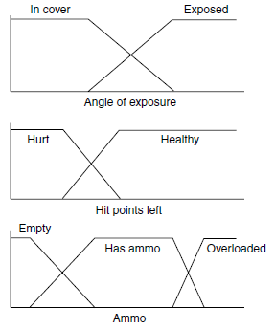
Fuzzy Logic Decision Making
Exclusive mapping to states for fuzzy decision making
(look further about the process at page 387-390 from your textbook)

Slide 6
Fuzzy State Machines
Although developers regularly talk about fuzzy state machines, they don’t always mean the same thing by it.
A fuzzy state machine can be any state machine with some element of fuzziness.
It can have transitions that use fuzzy logic to trigger, or it might use fuzzy states rather than conventional states.
It could even do both.

Slide 7
Fuzzy State Machines
Multiple Degrees of Transition
It is possible to have a different degree of transition per target state. The degree of membership for target states is calculated in the same way as before.
For example, say we have the following states:
State A: DOM = 0.5
State B: DOM = 0.6
State C: DOM = 0.4
Then applying the transition:
From A to B (DOT = 0.2) AND C (DOT = 0.7)
will give:
State B: DOM = max (0.6, min(0.2, 0.5)) = 0.6
State C: DOM = max (0.4, min(0.7, 0.5)) = 0.5
State A: DOM = min (0.5, 1−max(0.2, 0.7)) = 0.3

Slide 8
Markov Processes
We can represent the set of numerical states as a vector of numbers.
Each position in the vector corresponds to a single state (e.g., a single priority value or the safety of a particular location). The vector is called the state vector.
The values in the state vector change according to the action of a transition matrix. First-order Markov processes (the only ones we will consider) have a single transition matrix that generates a new state vector from the previous values. Higher order Markov processes also take into account the state vector at earlier iterations.

Slide 9
Markov Processes
Conservative Markov Process
A conservative Markov process ensures that the sum of the values in the state vector does not change over time.
This is essential for applications where the sum of the state vector should always be fixed (where it represents a distribution, for example, or if the values represent the number of some object in the game).
The process will be conservative if all the rows in the transition matrix sum to 1.

Slide 10
Markov Processes
Iterated Processes
It is normally assumed that the same transition matrix applies over and over again to the state vector.
There are techniques to calculate what the final, stable values in the state vector will be (it is an eigenvector of the matrix, as long as such a vector exists).
This iterative process forms a Markov chain.
In game applications, however, it is common for there to be any number of different transition matrices.
Different transition matrices represent different events in the game, and they update the state vector accordingly.

Slide 11
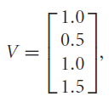
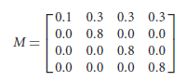
Markov Processes
Returning to our sniper example, let’s say that we have a state vector representing the safety of four sniping positions:
which sums to 4.0.
Taking a shot from the first position will alert the enemy to its existence. The safety of that position will diminish. But, while the enemy is focusing on the direction of the attack, the other positions will be correspondingly safer. We could use the transition matrix:

Slide 12
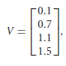
Markov Processes
to represent this case. Applying this to the state vector, we get the new safety values:
which sums to 3.4.
So the total safety has gone down (from 4.0 to 3.4). The safety of sniping point 1 has been decimated (from 1.0 to 0.1), but the safety of the other three points has marginally increased. There would be similar matrices for shooting from each of the other sniping points.

Slide 13
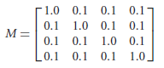
Markov Processes
Notice that if each matrix had the same kind of form, the overall safety would keep decreasing. After a while, nowhere would be safe. This might be realistic (after being sniped at for a while, the enemy is likely to make sure that nowhere is safe), but in a game we might want the safety values to increase if no shots are fired. A matrix such as:
would achieve this, if it is applied once for every minute that passes without gunfire.

Slide 14
Markov State Machines
Using Markov processes, we can create a decision making tool that uses numeric values for its states.
The state machine will need to respond to conditions or events in the game by executing a transition on the state vector.
If no conditions or events occur for a while, then a default transition can occur.

Slide 15
References
Ian Millington. 2009. Artificial intelligence for games. Morgan Kaufmann Publishers. Burlington. ISBN:9780123747310
Decision Making, https://www.cs.umd.edu/class/spring2013/cmsc425/Lects/lect20.pdf

